Slide 1
Is It better to live in a „normal” house or in an unusual house ?

Slide 2
Boat houSe

Slide 3
Positive things : -it’s difficult to break into -have water -no sound bother -fish food -when it's summer we don't need a pool

Slide 4
Negative:
-boat can drown in water -tsunami can drown you -when you swim, sharks can grab you -you can have seasicknes

Slide 5
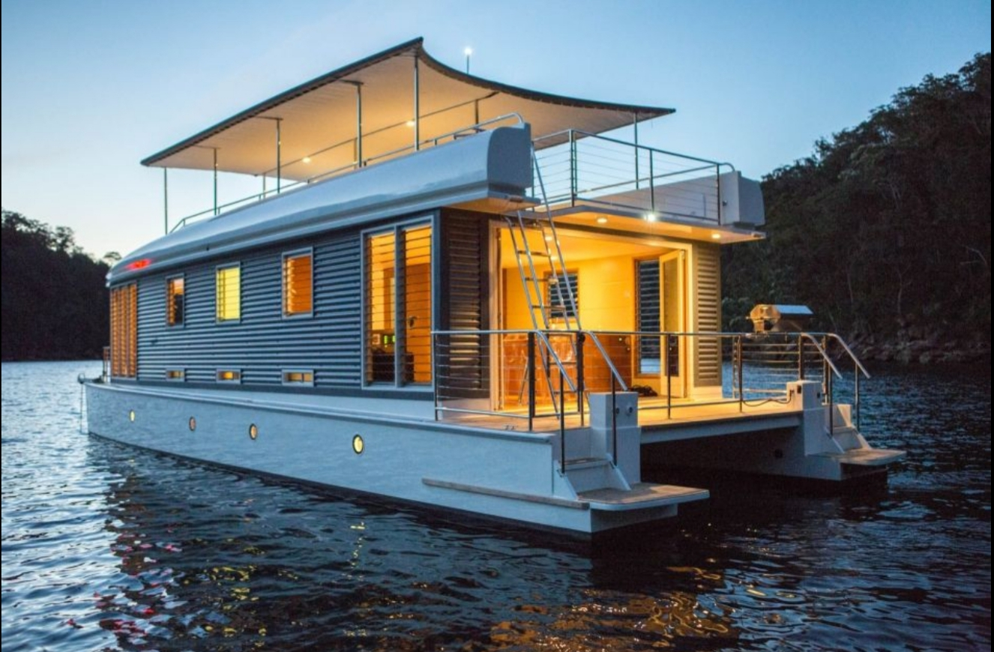
https://images.app.goo.gl/HyWVakvDXYhuwsw68

